Slide 1

Azure Queue Storage
Presented By: – Dev Nagar & Rajesh Barfa

Slide 2
Agenda
What is Azure Queue Storage?
Install Nuget Package
Development and Production for Azure Queue
Sample Code
Reference

Slide 3
Azure Queue storage is a service for storing large numbers of messages that can be accessed from anywhere in the world via authenticated calls using HTTP or HTTPS. A single queue message can be up to 64 KB in size, The maximum time that a message can remain in the queue is 7 days.. URL Format http://<storage account>.queue.core.windows.net/<queue>
About

Slide 4
Use NuGet to install the required packages
1..Microsoft Azure Storage Client Library for .NET
Solution Explorer=> Manage NuGet Packages.=> WindowsAzure.Storage=>Install
2. Microsoft Azure Configuration Manager library for .NET
Solution Explorer=> Manage NuGet Packages.=> ConfigurationManager=>Install

Slide 5
Determine your target environment
1. Development
Connection String:
<add key="StorageConnectionString" value="UseDevelopmentStorage=true;" />
2. Production
Connection String:
<add key="StorageConnectionString" value="DefaultEndpointsProtocol=https;AccountName=storagesample;AccountKey=nYV0gln6fT7....." />

Slide 6
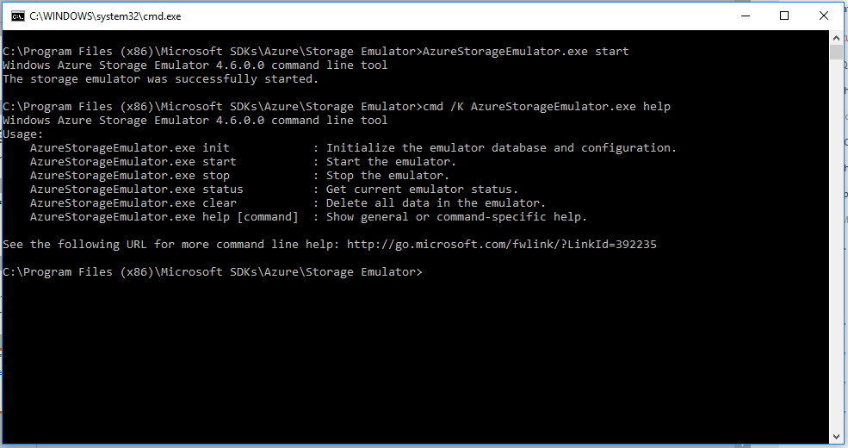
Use the Azure Storage Emulator for Development and Testing
Download
https://go.microsoft.com/fwlink/?linkid=717179&clcid=0x409

Slide 7
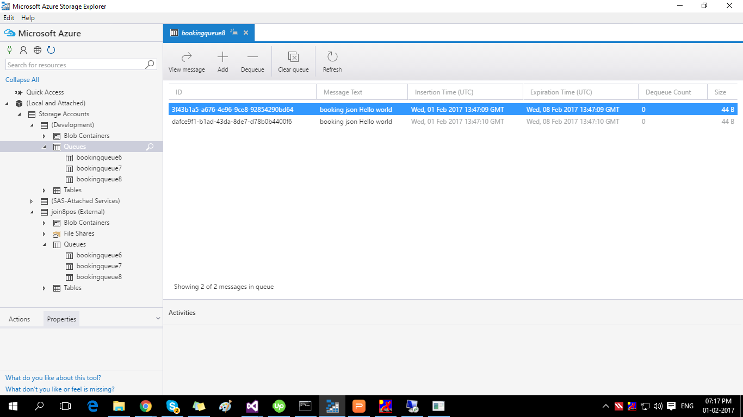
Microsoft Azure Storage Explorer Download From : http://storageexplorer.com/

Slide 8
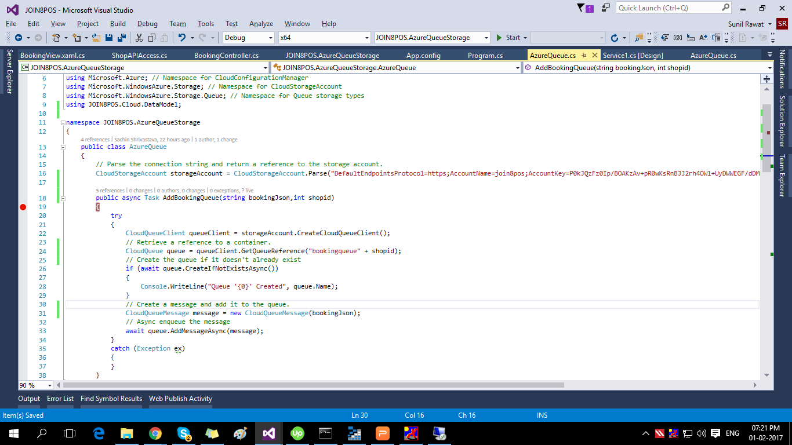
Sample Code

Slide 9
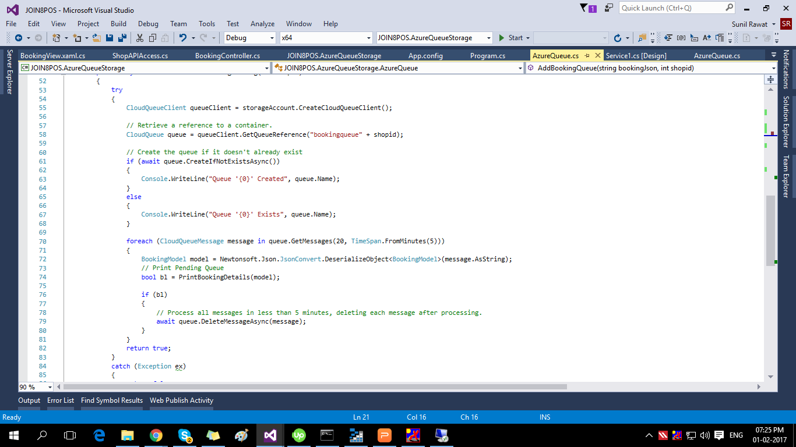
Get Queue Message and Dequeue Message

Slide 10
Sample Source Code: https://github.com/SystematixIndore/AzureQueueStorage
References:
1. https://docs.microsoft.com/en-us/azure/storage/storage-dotnet-how-to-use-queues
2. https://docs.microsoft.com/en-us/azure/storage/storage-use-emulator
3. https://docs.microsoft.com/en-us/azure/storage/storage-configure-connection-string

Slide 11

Thank You

